Slide 1
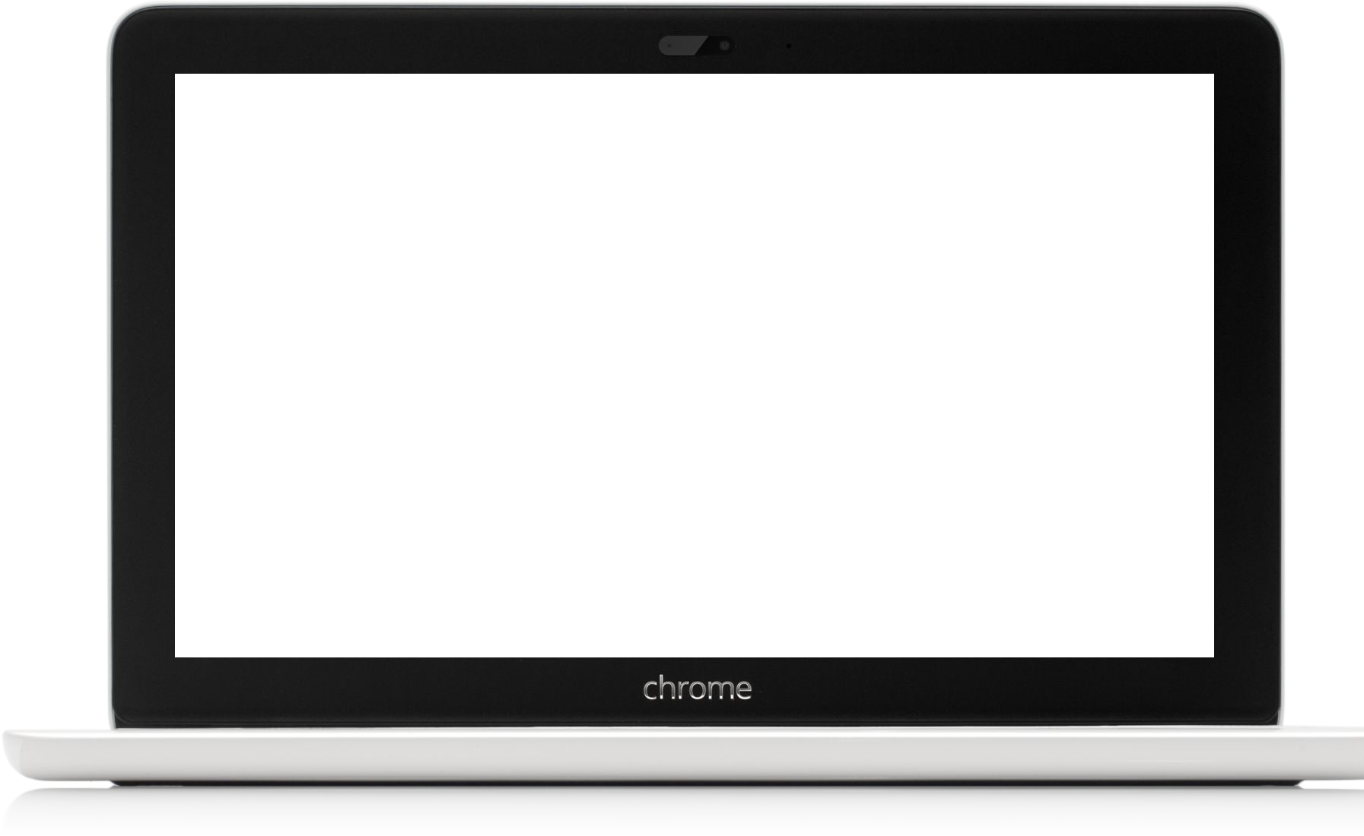
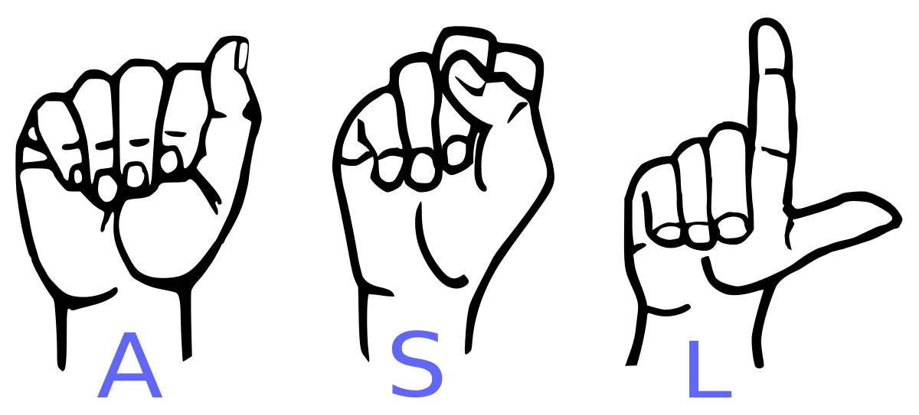
Serenity: Sign Language to Text Translator

Slide 2

Group no. 3
Project Under Supervision of
Prof Kavita Jain
Novi Andrades – 202101003
Alicia Dsouza – 202101017
Alita Fernandes – 202101019
Sharan Shetty - 202101056

Slide 3
Abstract
Our project aims to create a computer application and train a model which when shown a real time hand gesture of American Sign Language, it shows the output for that particular sign in text format on the screen.

Slide 4
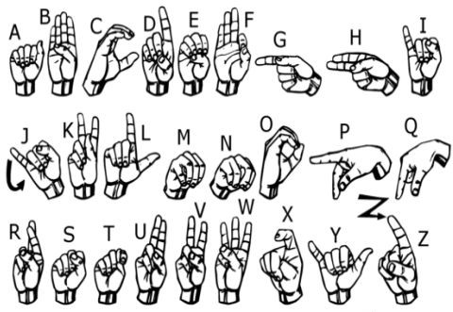

Slide 5
Literature Survey

Slide 6
➔

Slide 7
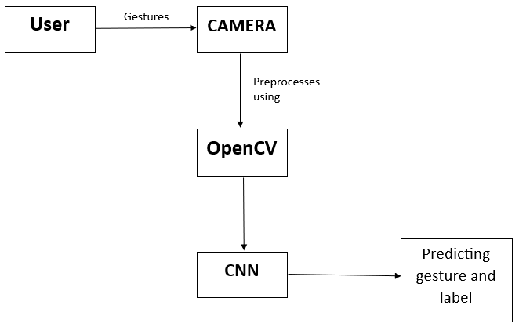
Proposed Design: Block Diagram

Slide 8
Software Requirements
Python 3.6.6
Tensorflow 1.11.0
OpenCV 3.4.3.18
NumPy 1.15.3
Matplotlib 3.0.0
Hunspell 2.0.2
Keras 2.2.1
PIL 5.3.0

Slide 9
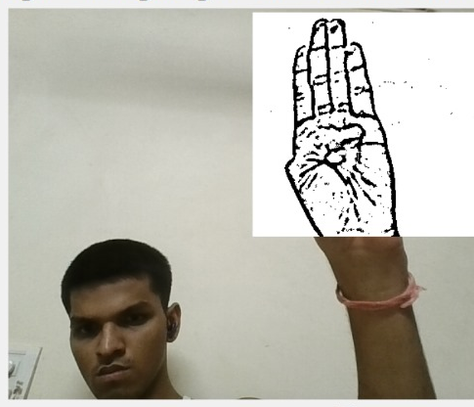
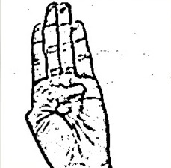
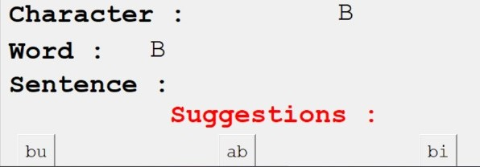
Capturing Raw Image

Slide 10

Results:

Slide 11
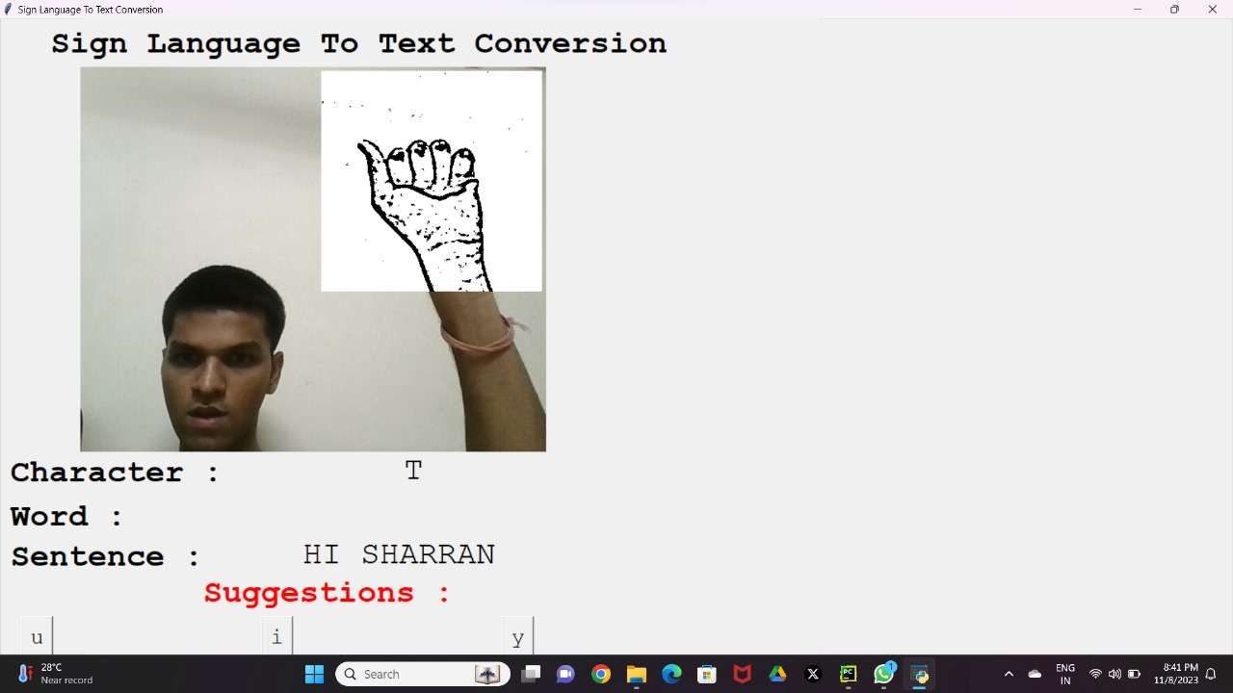

Slide 12
Conclusion:
This report presents a real-time vision-based system designed for precise American Sign Language (ASL) alphabet recognition. By employing a sophisticated dual-layered algorithm, this system excels in distinguishing ASL. With optimal conditions, it proficiently recognizes nearly all ASL alphabets, showcasing inclusivity for the Deaf and Hard of Hearing community.

Slide 13
References:
[1] A. Sharma, S. Panda and S. Verma, ”Sign Language to
Speech Translation,” 2020 11th International Conference on Computing, Communication and Networking Technologies (IC- CCNT), Kharagpur, India, 2020, pp. 1-8, doi: 10.1109/ICC- CNT49239.2020.9225422.
[2] W. Li, H. Pu and R. Wang, ”Sign Language Recognition Based on Computer Vision,” 2021 IEEE International Conference on Artificial Intelligence and Computer Applications (ICAICA), Dalian, China, 2021, pp. 919-922, doi: 10.1109/ICAICA52286.2021.9498024.
[3] V. N. T. Truong, C. Yang and Q. Tran, ”A translator for American sign language to text and speech,” 2016 IEEE 5th Global Conference on Consumer Electronics, 2016, pp. 1-2, doi: 10.1109/GCCE.2016.7800427.

Slide 14
[4] Y. Madhuri, G. Anitha. and M. Anburajan., ”Vision-based sign language translation device,” 2013 International Conference on Infor- mation Communication and Embedded Systems (ICICES), Chennai, India, 2013, pp. 565-568, doi: 10.1109/ICICES.2013.6508395.
[5] Rokade, Yogeshwar Jadav, Prashant. (2017). Indian Sign Language Recognition System. International Journal of Engineering and Technology. 9. 189-196. 10.21817/ijet/2017/v9i3/170903S030.
[6] Slabaugh, G., Boyes, R. and Yang, X., 2010. Multicore image processing with OpenMP [applications corner]. IEEE Signal Processing Magazine, 27(2), pp.134-138

Slide 15
Thank You !

